Slide 1
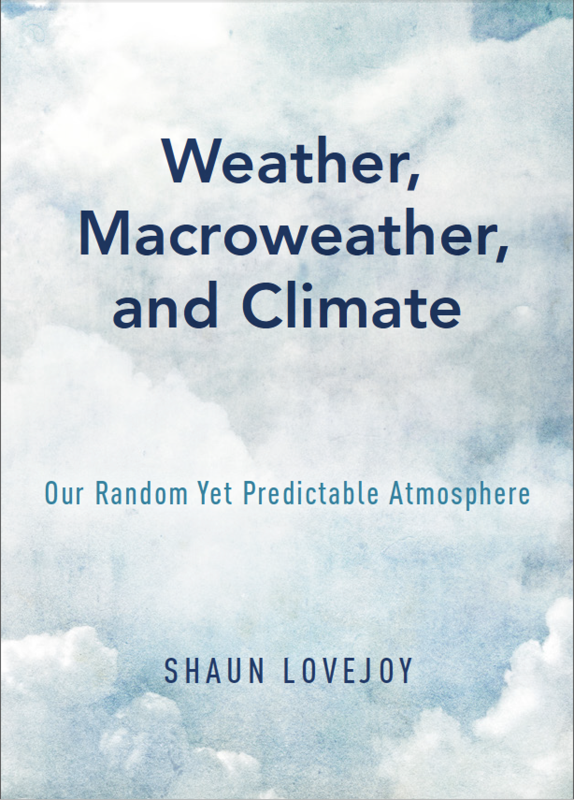
Richardson lecture
European Geosciences
Union,
Vienna
9 April, 2019
Reuniting Richardson’s strands
McGill,
Montreal,
Canada
Notes:
Thank you for the kind introduction.
Before I get started, I would like to acknowledge collaborations with numerous colleagues, in particular, a long one with Daniel Schertzer.
It is especially fitting that today’s presentation is in honour of Richardson. Richardson initiated the two fundamental strands of atmospheric science that I will discuss today. In the 1920’s he proposed two apparently contradictory ways of apprehending the atmosphere: deterministic and stochastic.
My aim today is to convince you that although for a long time these approaches have been separate, that today they can be reunited; a reunification that enriches our theoretical understanding of the atmosphere while giving us new ways of predicting and projecting it’s future state.
So what is the problem that we are facing?

Slide 2
Zooming through spatial scales by the
billion
1mm - 10,000 km

Slide 3

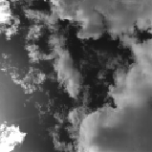
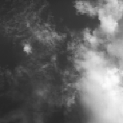
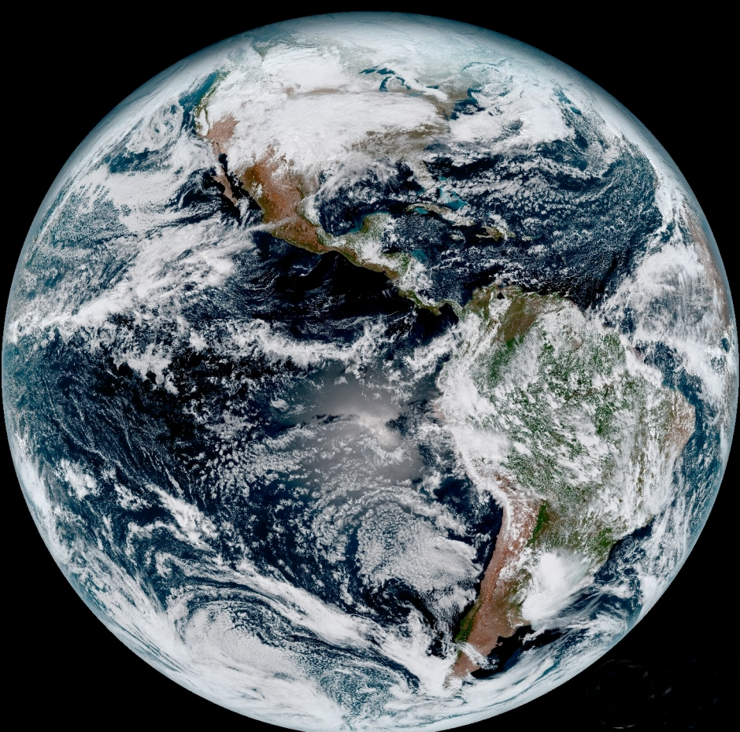
A voyage through scales: Space, 0.1mm – 10,000km
10km
1m
20,000km
1mm

Slide 4
Zooming through time scales by the
billion billion
milliseconds to half a billion years

Slide 5
A voyage through scales: Time, 0.001s – 4.5 billion years
  Zooming in time: Benthic Paleoindicators
4
Phanerazoic eon
50ºC
100
200
300
400
500
Age (Myr BP)
-
5
-
10
cold
4
3
Cenozoic era
10ºC
2
1
hot
-
1
10
20
30
40
50
60
Age (Myr BP)
Notes:
Final 1.4a
(4.5K/δ¹⁸O) excpet Huybers which uses 6.5K/mil

Slide 6
Montreal Temperatures at increasing resolution
ºC
10
5
-
100
200
300
400
500
600
700
5
-
10
-
15
138 years
x16
-
20
-
25
Fluctuations tend to cancel
ºC
10
5
-
100
200
300
400
500
600
700
5
-
10
-
15
x16
-
20
8.4 years
-
25
10
ºC
5
-
100
200
300
400
500
600
700
5
-
10
-
15
6 months
-
20
X 324,000
ºC
100
200
300
48 s
400
500
600
700
Fluctuations don’t cancel much
-
Notes:
above is Montreal long. detreneded once, factors of 2, 700mb from 1871-2008 fixed range +10C to -25C
{70., 35., 17.5, 8.75, 4.25, 2., 1., 0.5, 0.25} lengths in days
{137.988, 68.9938, 34.4969, 17.2485, 8.37782, 3.94251, 1.97125, 0.985626, \
0.492813}length of record in yrs

Slide 7
How to understand this mind-boggling variability? (1)
Two strands of atmospheric science
Deterministic or random?

Slide 8
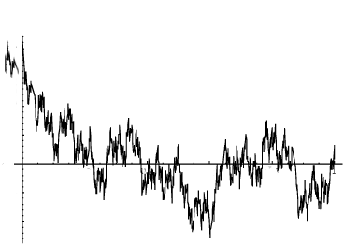
Which Chaos:
Deterministic or Stochastic?
1 second, resolution: 0.5ms
v(t)
1.7
1.5
Data, roof of physics building
Wind speed (m/s)
1.3
1.1
t
v(t)
v(t)
Deterministic simulation
(NWPs, GCMs are deterministic)
Stochastic simulation
(turbulent laws)
t
t
Wierstrasse function…proposed by Richardson 1926: “Does the wind have a velocity?”
Highly intermittent, Fractionally Integrated Flux (multifractal) cascade model (Schertzer+ Lovejoy, 1987)
Notes:
Final. Fig. 1.3
Right is Wierstrasse, left is multifractal, top is data

Slide 9
Cosmos versus Chaos through the ages
Determinism: Newton, (1643-1727), Laplace (1749-1827)
Chance: Ignorance, subjective
“Le hasard n'est rien…”, “Chance is nothing” Voltaire: (1694-1778).
Chance: Irrelevance of the details
Statistical Physics (Maxwell, Gibbs, Boltzman, 1870-1900).
Chance: Objective chance, Stochastic Chaos systems with many degrees of freedom
Quantum Mechanics: Born interpretation of the wave function (1926)
Mathematics: Kolmogorov’s axiomatization of probability theory (1933).
Determinism: Random-like Deterministic Chaos systems with few degrees of freedom (Lorenz 1963).
Notes:
Last two only

Slide 10
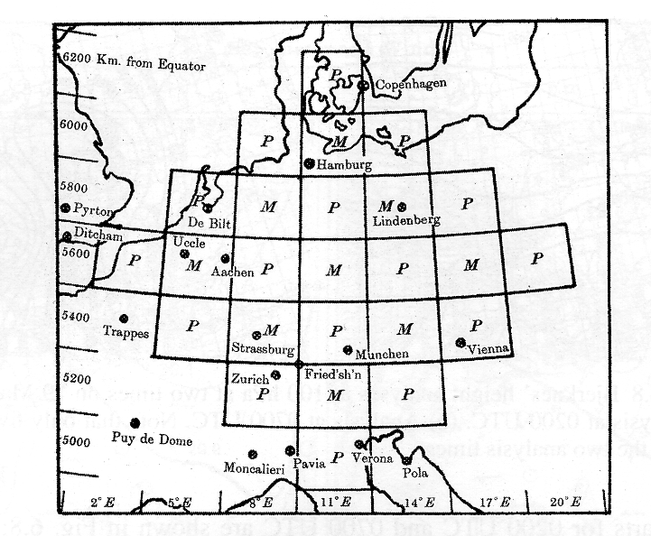
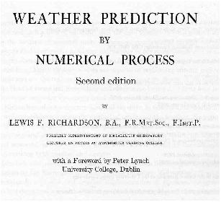
The pressure tendency at central grid point
Janus-faced
Richardson’s two strands
1922
1926
Richardson and NWP
Richardson, turbulence, scaling
Deterministic
Father of numerical weather prediction
Grandfather of turbulent cascades
Stochastic
“Big whirls have little whirls that feed on their velocity, little whirls have smaller whirls and so on to viscosity (in the molecular sense).”
Vindicated in the 1970’s
Vindicated in 2013
The Richardson 4/3 law
Turbulent diffusion
It took six weeks of calculation… and he was wrong by a factor of 100!
Notes:
Emphasize wide range on Richardson plot

Slide 11
Two revolutions: unity lost
Up until 1970’s weather and climate science were a pragmatic combination of both deterministic and statistical approaches.
The Numerical revolution: NWPs, GCMs
The Nonlinear revolution
Initialization
Ensemble forecasting
3D, 4D var (data assimilation)
Extension to climate
Earth System Models
Deterministic chaos
Stochastic chaos
Fractals, multifractals
Scaling symmetries
Anisotropic scaling
Numerical simulations
Theoretical Understanding
2010’s: Unity refound?
GCMs respect scaling laws…
Control runs can be stochastically forecast…
Scaling yields less uncertain climate projections
Notes:
20 minutes

Slide 12
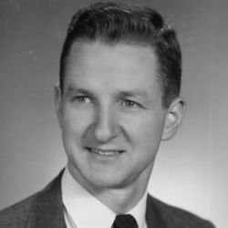
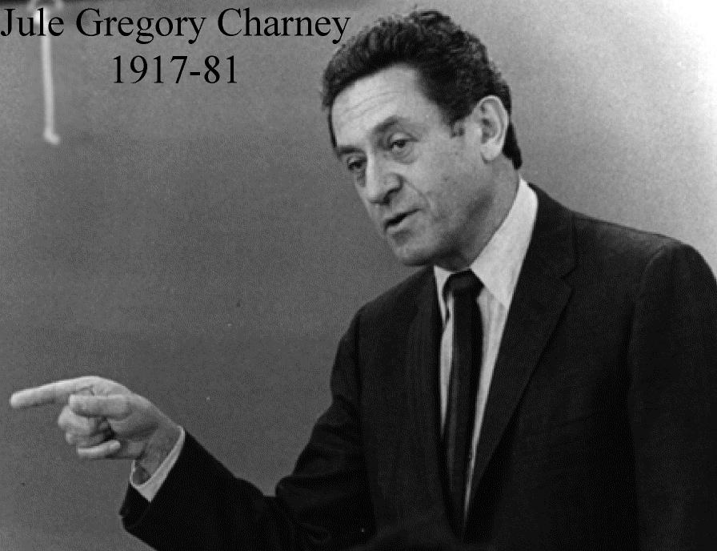
The neglected strand of atmospheric science:
Pioneers of turbulence
Richardson
1881 - 1953
Kolmogorov
1903 – 1987
Obukhov
1918 – 1989
Corrsin
1920 – 1986
Mandelbrot
1924-2010
Ralph Bolgiano, Jr.
1922 — 2002
Jule Charney
1917 — 1981

Slide 13
Laws of Atmospheric Turbulence
Pioneers
Differences
homogeneous
Isotropic
Fluctuations ≈ (turbulent flux) x (scale)^{H}
Anisotropic
Space-time
Scale function
Wavelets
Cascading, Multifractal
Turbulent flux
1980’s-present
(nonlinear revolution)
Notes:
Remove Fourier to later

Slide 14
How to understand this mind-boggling variability? (2)
High level or low level laws?

Slide 15
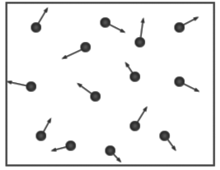
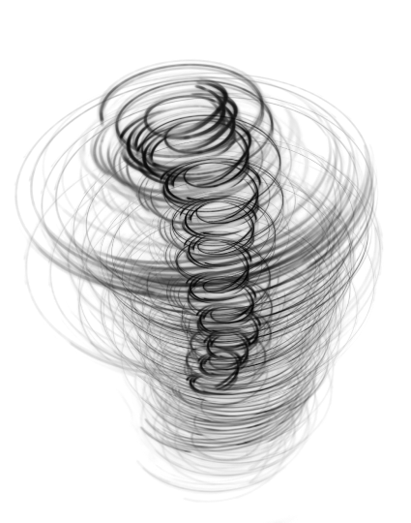
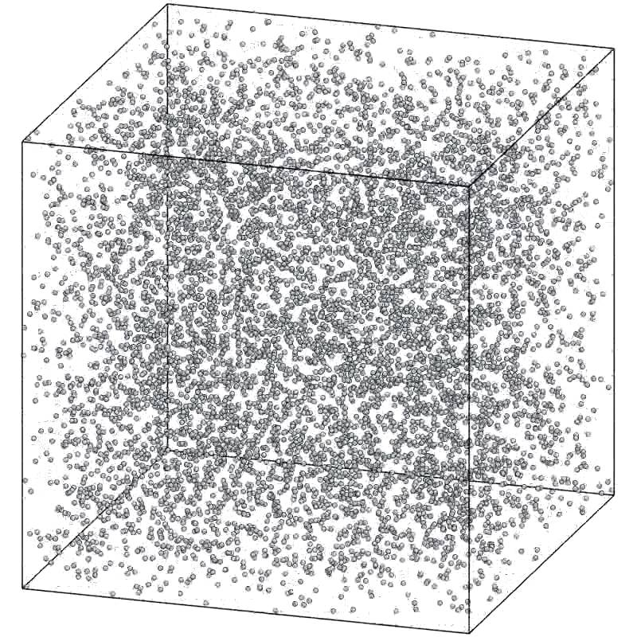
Emergent laws: Which level?
Collective behaviour of
Thermodynamics, continuum mechanics, NWPs, GCMs
Statistical Mechanics:
many particles
Mechanics of a few particles
Irrelevance of most of the details, collective behaviour of many, many components

Slide 16
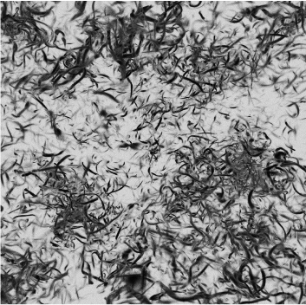
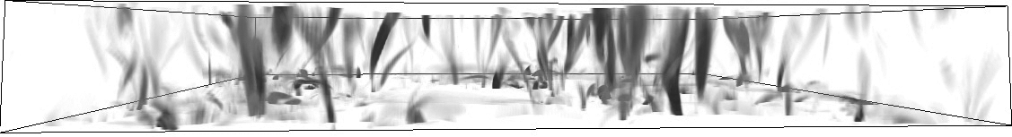
The hierarchy continues
Collective behaviour of many vortices: Turbulent laws
Continuum mechanics
of a single vortex
Irrelevance of most of the details, collective behaviour of many, many components
“spaghetti” picture
Continuum mechanics
Of several vortices

Slide 17
What about the “details”?
Low level: account for as many details as possible…
Supercomputers
High level: Most details are irrelevant, we just need their statistics
Laptops
Notes:
At bottom of previous?

Slide 18

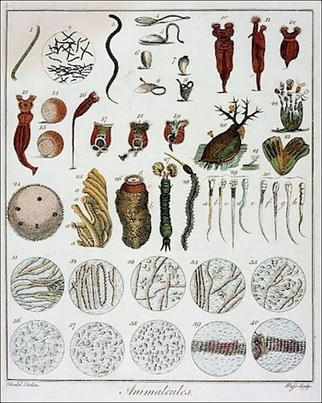

The details and scale: the
Scalebound view
Van Leeuwenhoek discovering a “new world” in a drop of water (circa 1690)
Notes:
27 minutes to here
Final. Fig. 2.1
“Animalcules,” described in depth by Leeuwenhoek, c1695–1698. By Anton van Leeuwenhoek
http://www.blog-nouvelles-technologies.fr/94478/antoni-van-leeuwenhoek-anniversaire-google-doodle/

Slide 19
Scalebound “Powers of ten”
century
decade
one year
one day
Billion years
million years
one month
thousand years
Official National Oceanographic and Atmospheric Administration (NOAA) website 2015

Slide 20
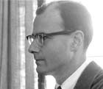
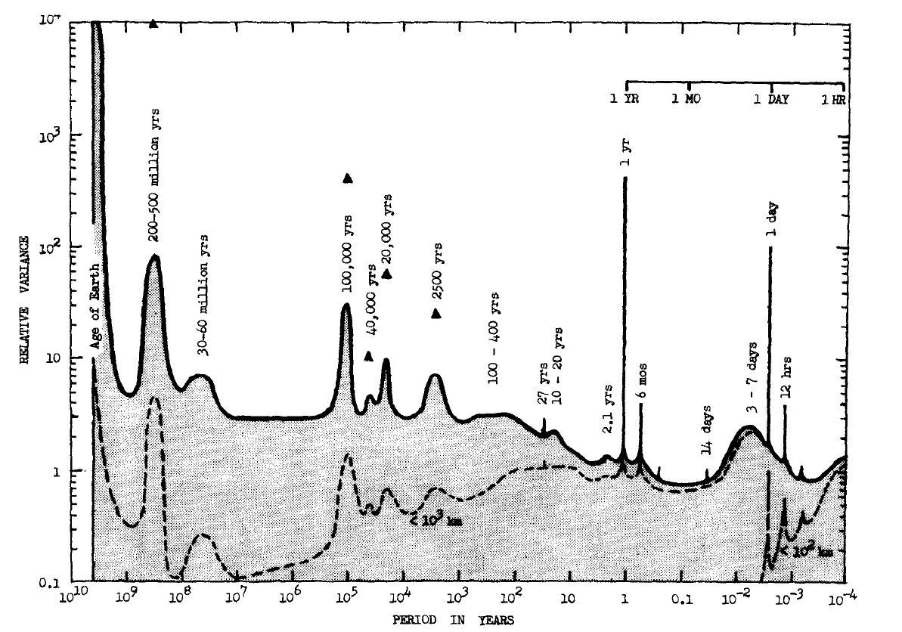
The missing quadrillion: 1976 versus 2014
10⁵
Atmospheric dynamics 1 hour- 10⁹ yrs: Mitchell 1976 (grey, bottom)
K²yr
β = 1.8
1
β = 1.8
Murray Mitchell
Murray Mitchell on his head
10¹⁵
β = -0.6
Log₁₀E(ω)
megaclimate
climate
macroweather
weather
β = 0.2
10⁻⁵
Macroclimate
β = 0.6
β = 1.8
β = 2.6
10⁻¹⁰
“Educated guess”
10⁻⁹
10⁻⁶
10⁻⁵
10⁻²
Log₁₀ω (yr)⁻¹
10²
10⁴
Notes:
GOOD!! Tauw=20 days, tauc=50 yrs, taumc=80kyrs, tauMc=500 kyrs
The 20CR has been moved up by 2 Pi and down by 0.2 (to account for the 700mb level), the dashed green transition lines have been adjusted accordingoly.
Epica moved down by 0.25
Apparently as required by analysis
Huybers at 4ky resolution, small intermittency corrections for Zachos (=-0.25) and Veizer (-0.45), assuming K(2)=0.2. Huybers, Zachos using 6.5K/18O, Veizer using 4.5 K/18O
Annual cylce at one day res is about 10**3 above the bacground, shown for the global average: green spike
Green is Moburg and Huang at 2 yr res.
With white-oput, Huybers is at 2 kyrs
Huyber: res =1 kyr
Zachos=18 kyrs
Veizer 185 kyrs
Mitchell, 1976
“educated guess”, borwn is roughly Schakleton and Imbrie 1990

Slide 21
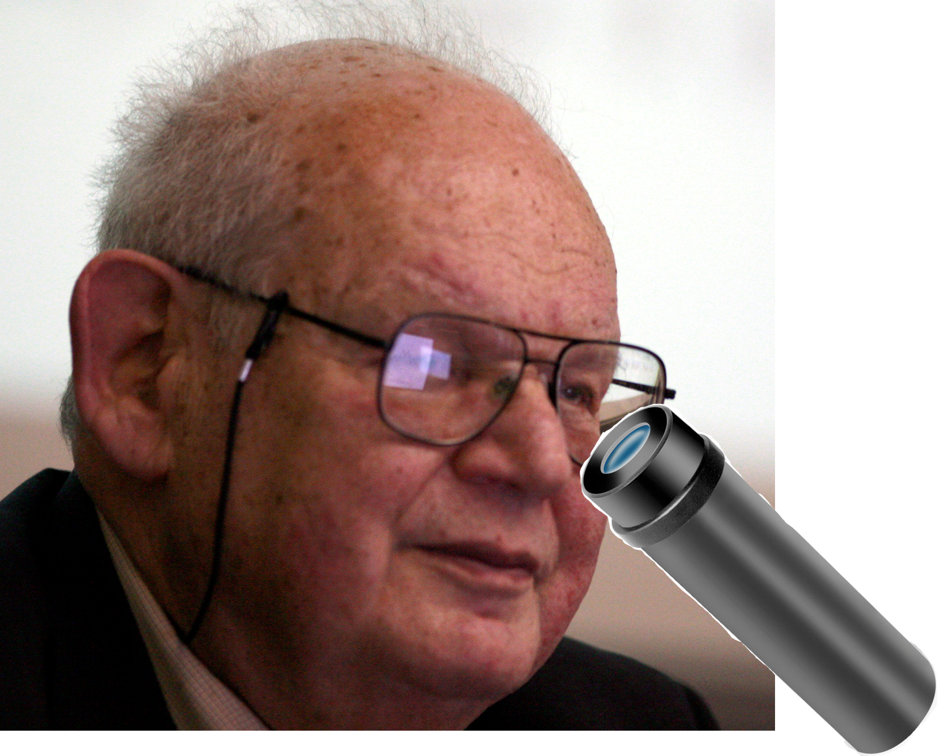
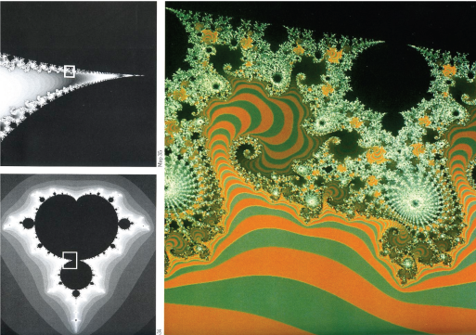
Details: The Scaling view
Mandelbrot (1924-2010) zooming into the Mandelbrot set
Notes:
Final, fig. 2.6 (new numbering)

Slide 22
Classifying dynamical regimes: Scale Invariance

Slide 23
New simple technique (re)discovered in 2012: Fluctuation analysis
Scaling regimes
ΔT (ºC)
Based on Haar wavelets (1910)
20 ºC
RMS Fluctuations
10 ºC
Anthropogenically forced
Lifetime planetary structures
5 ºC
Astronomical+?
1 second
1 hour
10 days
1 year
1ºC
10⁻⁸
10⁻⁷
10⁻⁶
10⁻⁵
10⁻⁴
10⁻³
10⁻²
10⁻¹
10
10²
10³
10⁴
10⁵
10⁶
10⁷
10⁸
10⁹
Δt (yrs)
0.5ºC
Industrial
climate
weather
Pre-industrial
megaclimate
0.2 ºC
macroclimate
macroweather
0.1ºC
Notes:
23
Final fig. 2.4a (new numbering)
GOOD WITH some of the old series in dashed, backgorund
Note, fixed: 0.25->0.4oC
Top Huyber 6.5K/mil, Zachos and Veizer: 4.5K/mil, rectangel, ±2 to ±4
1 hour-5.53x10⁸yrs
GOOD
All, no interpolation
No interpolations!!!
Zachos: last 32Myrs=Oligocene: 70% variation of delta18O is due to ice. Based on 40 ODP, OSDP cores (Deep sea=>1km depth).
Fig. 10.30 a
NEW with better detrended 20CR.
This shows RMS (top of each pair) and q=1, GRIP calib: 0.5K/mil

Slide 24
ΔT≈Δt^{H}
2
Megaclimate
Veizer: 290 Mys - 511Myrs BP (1.23Myr)
H ≈ 0.4
growing
1
Megaclimate
Zachos: 0-67 Myrs (370 kyr)
H ≈ - 0.8
0
Macroclimate
Huybers: 0-2.56 Myrs (14 kyrs)
decreasing
Temperature
Climate
Epica: 25-97 BP kyrs (400 yrs)
H ≈ 0.4
-
1
growing
H ≈ - 0.4
-
2
Macroweather
Berkeley: 1880-1895 AD (1 month)
decreasing
-
3
Weather
Lander Wy.: July 4-July 11, 2005 (1 hour)
H ≈ 0.4
growing
-
4
Weather
Thermistor, Montreal (0.017s)
t
50
100
150
Notes:
180 points each, normlized over the range, zeroed and then offset by one unit, top isVeiz, 1.23 Myr res. from 290 to 511 Myrs in the past, range 10.1 18O, middle is Zach, 370 kyrs, over last 66.6 Myrs, range 4.59 18O, bot is Huy at 14 kyrs,last 2.52 Myrs, range is 1.61 18O, bottom is Epica at 400 years res, over period 24662 years to 96562, range = 6.87K, Bottom is BErk, global land, monthly res, 1870-1895, detrended 5 times, range 2,50 K, mean =-0.41, bottom is Lander at 1 hour res, 7.5 days at 1 hour res: March 14-March 22, 2005, range 25K, mean=12 K

Slide 25
Scaling, scale invariance:
Typical Fluctuation ≈ (scale)^{H}
H>0: Fluctuations grow with scale, unstable
H<0: Fluctuations decrease with scale, stable
“The climate is what you expect, the weather is what you get”
Expect Macroweather!
Weather: H>0, macroweather, H<0, climate, H>0
Notes:
Note: For Gaussian processes, H > 1/2: “persistence”; H < 1/2: “antipersistence”

Slide 26
Multifractality, Intermittency
14
14
14
12
Weather
12
Macroweather
12
Climate
10
10
10
Time
Montreal at 1 hour
Montreal at 4 months
GRIP ice core ¹⁸O at 240 year resolution
8
8
p = 10⁻⁹
8
6
6
p = 10⁻⁶
6
4
4
p = 1/360
4
2
2
2
0
50
100
150
200
250
300
350
0
50
100
150
200
250
300
350
0
50
100
150
200
250
300
350
The quasi-Gaussian exception
14
14
14
12
Pr(γ’>γ) ≈ λ^{−c(γ)}
12
12
10
aircraft at 280 m
λ^{γ}
10
ECMWF reanalysis , one month, 1º in space
10
20C reanalysis 140 years, 2º in space
Space
8
8
8
6
6
6
4
4
4
2
2
2
0
50
100
150
200
250
300
350
0
50
100
150
200
250
300
350
0
50
100
150
200
250
300
350
Notes:
Move time and space labels to the right
Fig. 2a: Temperature spike plots for weather, macroweather, climate (left to right) and time and space (top and bottom). The solid horizontal black line indicates the expected maximum for a Gaussian process with the same number of points (360 for each with the exception of the lower right which had only 180 points), the dashed lines are the corresponding probability levels p = 10⁻⁶, p = 10⁻⁹ for Gaussian processes, two of the spikes exceed 14; p < 10⁻⁷⁷.
The upper left is Montreal at 1 hour resolution (data set #3; these numbers refer to table M1), upper middle, Montreal at 4 month resolution (#4), upper right, GRIP at 240 year resolution (#5), lower left, aircraft at 280 m resolution (#9), ECMWF, space, one month, 1º in space (#11), Twentieth Century Reanalysis (20CR), 140 year res, 2º in space at 45ºN, (#12); this has only 180 points.

Slide 27
Multifractal processes
Scaling of fields
Random generation of strong structures: “singularities”
Cascades: generic multifractal process
Stable, attractive universality classes
Power law extremes, black Swans, spurious oscillations (Fourier)
Discussed in short course (Wednesday)

Slide 28
Atmospheric spatial scaling (weather regime)
How is it that in 2019 there is no consensus on the large scale statistical properties of the atmosphere?

Slide 29
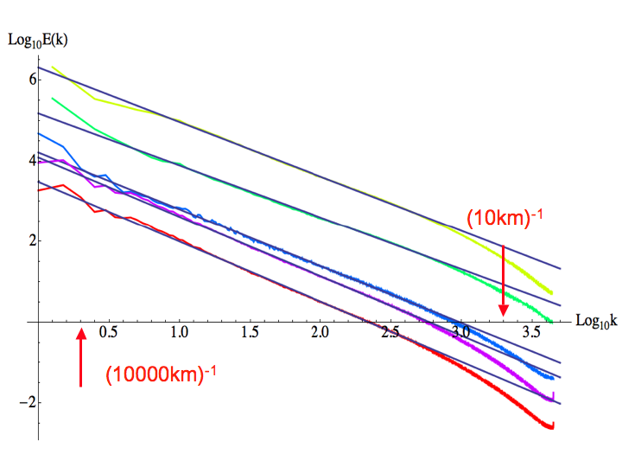
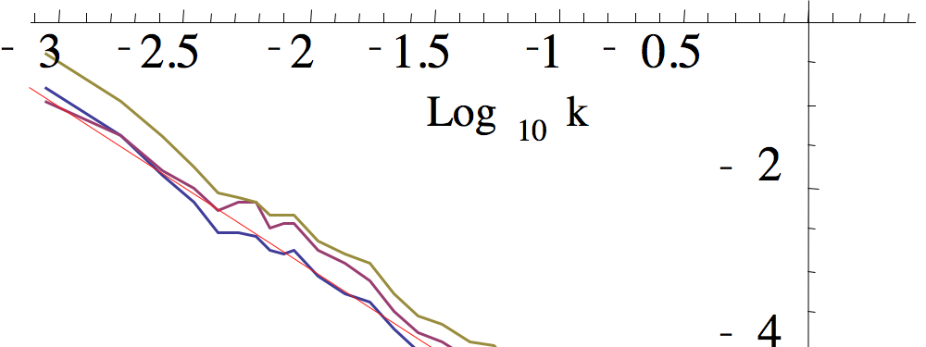
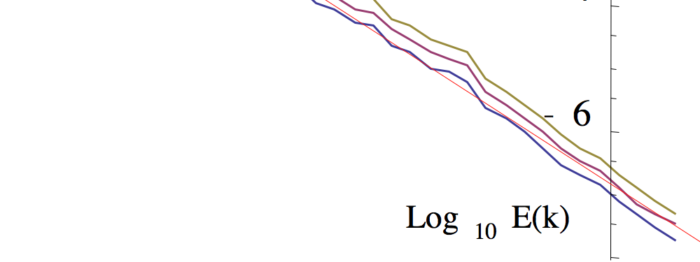
Planetary scale Horizontal Scaling
Satellite: TRMM visible, IR, 1000 orbits
9
Log
E
(
k
)
Satellite: TRMM microwave, 1000 orbits
10
0.63m
TMI 8
2008
-5/3
8
1.60μm
7
0.3-2.2 cm
3.75μm
TMI 5
6
10.8 μm
5
TMI 3
4
-5/3
TMI 6
12.0 μm
TMI 1
2008
3
(20000 km)⁻¹
(100 km)⁻¹
0.5
1.0
1.5
2.0
2.5
Log
10
k
(1000 km)⁻¹
Aircraft: 24 legs
(1 km)⁻¹
Log
E
(
k
)
Reanalysis: ECMWF interim 700 mb, ±45º, 1 year
6
10
z (geopotential height)
4
u (zonal wind)
-3
2010
Logθ
2
T (temperature)
h
(10000 km)⁻¹
w (vertical wind)
(1000 km)⁻¹
Log
k
2009
E(k)≈k⁻²
0.2
0.4
0.6
0.8
1.0
1.2
1.4
10
T
-
2
Rain rate
-5/3
-
4
humidity
Notes:
Top to bottom: Beta=1.35, 1.29, 1.41, 1.47, 1.49, wavelength=0.63, 1.60, 3.75, 10.8, 12.0
29

Slide 30
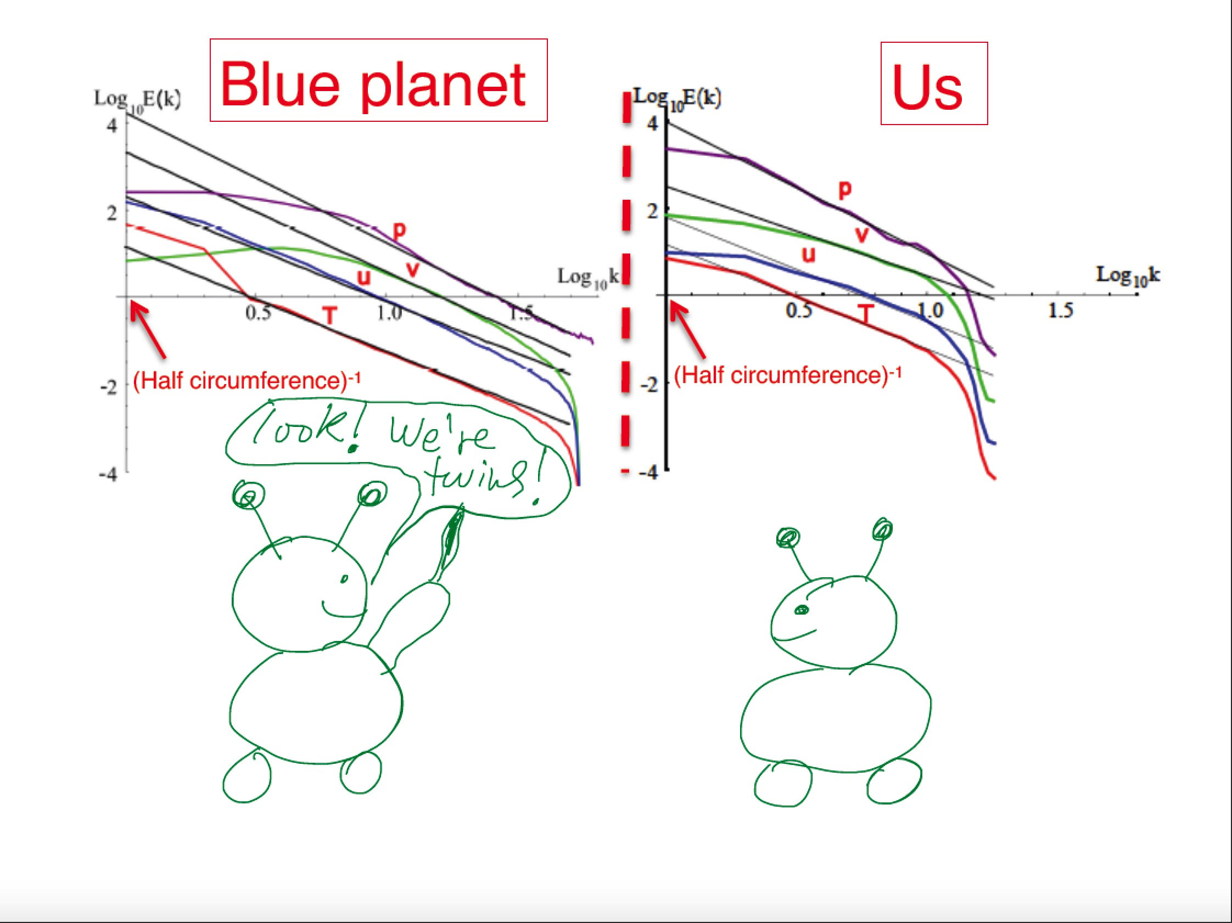


Earth Versus Mars
Comparing spectra from reanalyses
With P. Muller (2016)
“solar system” universality

Slide 31
How big is a cloud?
The emergence of scale
Generalized Scale Invariance, scaling stratification, 23/9D model
Scherzter+ L (1985)
(short course, Wednesday)

Slide 32
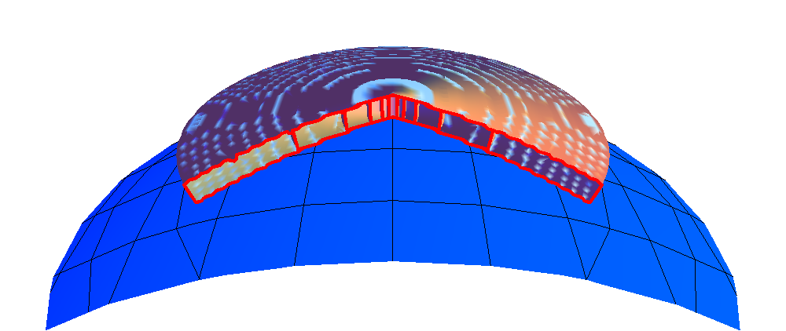
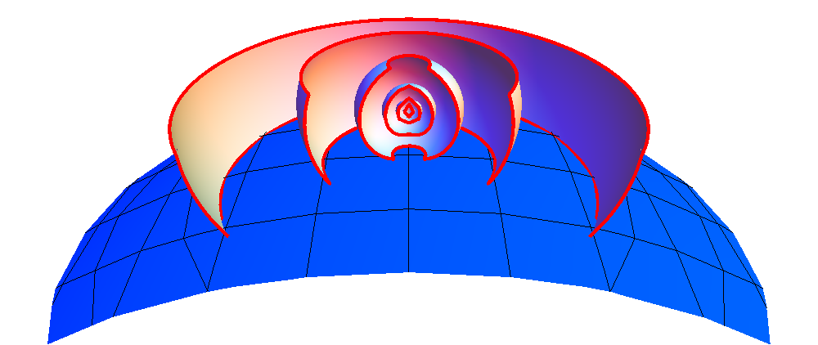
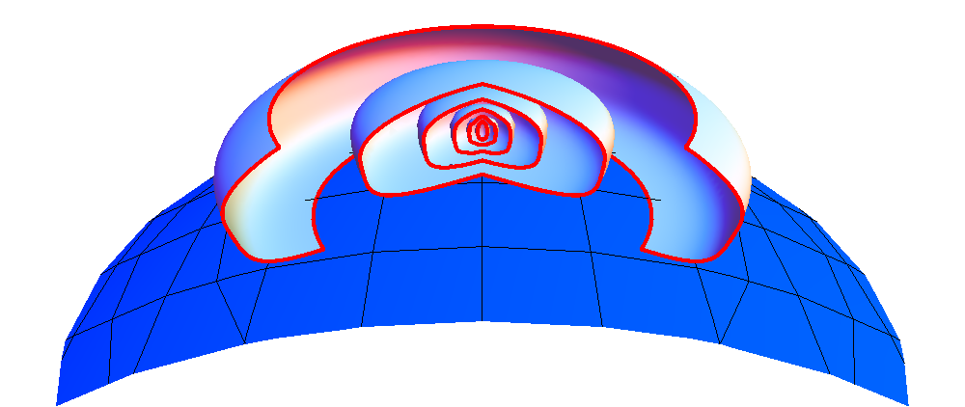
The 23/9D model
(Schertzer + L 1985)
D_{el}=2
D_{el}=3
L
L
h
L
Vol ≈ L.L.h ≈ L²
L
Vol ≈ L.L.L ≈ L³
L
D_{el}=1+1+H_{z} =23/9=2.555…
L
Cloudsat:
D_{el} = 2.57±0.02
L^{Hz}
Vol ≈ L.L.L^{Hz} ≈ L^{Del}
L
The 23/9D dynamics:
Bolgiano-Obukhov
H_{z}=(1/3)/(3/5)=5/9
Kolmogorov

Slide 33
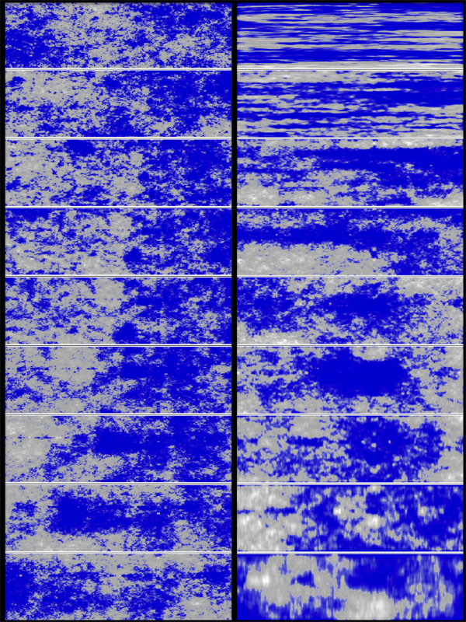
Anisotropic, Stratified Scaling
Stochastic
5km
Blow up X 2.9,
“squashing” X 1.6
(each)
Blow up X 2.9 (each)
Isotropic
Anisotropic
Generalized Scale Invariance
Total: X5000
1 m
H_{z} = 1
H_{z} = 5/9

Slide 34
Scaling in probability space:
Extremes,
Black swans,
Spurious oscillations
Abrupt changes,
Tipping points….
Mechanisms:
Central limit theorem (q_{D}<2)
Cascades: Multifractal Butterfly effect/1st order Multifractal phase transitions
Self-Organized Criticality
Continuous Additive and Multiplicative noise
(short course, Wednesday)
Notes:
55 minutes to here

Slide 35

Predictions and projections should be based on real world climates
Weather systems (<10 days) generated by GCMs
= random weather noise (statistics)…
but not fully realistic
Model climate
Our climate
Key finding: The models have surprisingly accurate statistical variability.
But each varies around its own climate - not the real world climate.
Scaling models can use data to force convergence to the real climate.

Slide 36

Using scaling for macroweather (long range) forecasts
http://www.physics.mcgill.ca/StocSIPS/
Stochastic Seasonal to Interannual Prediction System
Based on high frequency response of the Fractional Energy Balance Equation
t<<τ
τ ≈ 2yrs
H ≈ 0.4
New stochastic predictability limits… achieved on GCM control runs
With L. Del Rio Amador

Slide 37
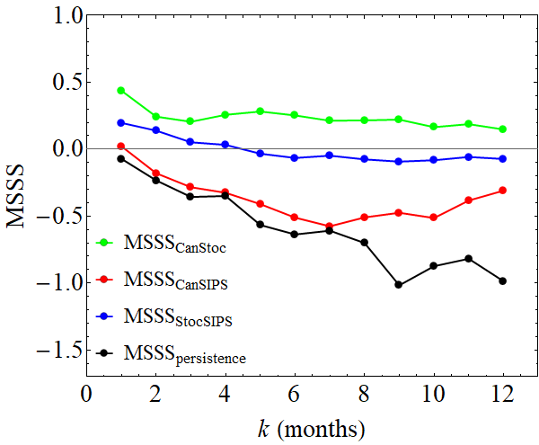
Mean skill Hindcasts of Global Mean Temperature Anomalies
Perfect forecast
CanStoc = hybrid
StocSIPS (stochastic)
skill
CanSIPS (GCM)
Based on fGn model
StocSIPS = Stochastic Seasonal and Interannual Prediction System
Negative skill
persistence
GCMs
CanSIPS = Canadian Seasonal and Interannual Prediction System
0
2
4
6
8
10
12
Lead time (months)
Hybrid
CanStoc = CanSIPS -StocSIPS hybrid
Training: 1980-2000
Verification : 2001-2010
Notes:
Skip
MSSS = Mean Square Skill Score =
1 -(Mean Square Error/ Anomaly Variance)

Slide 38
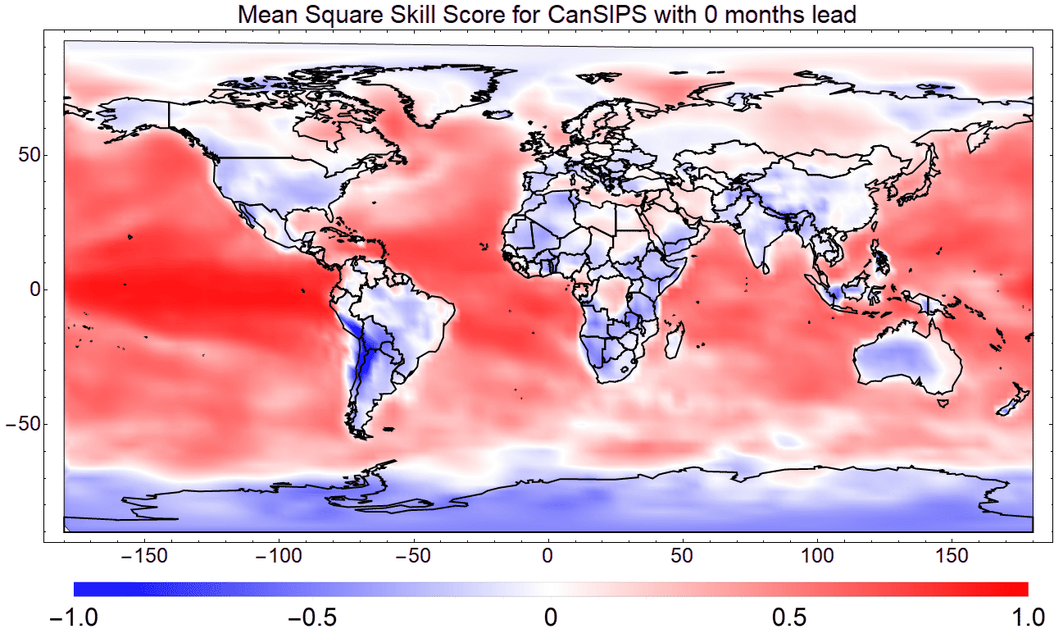
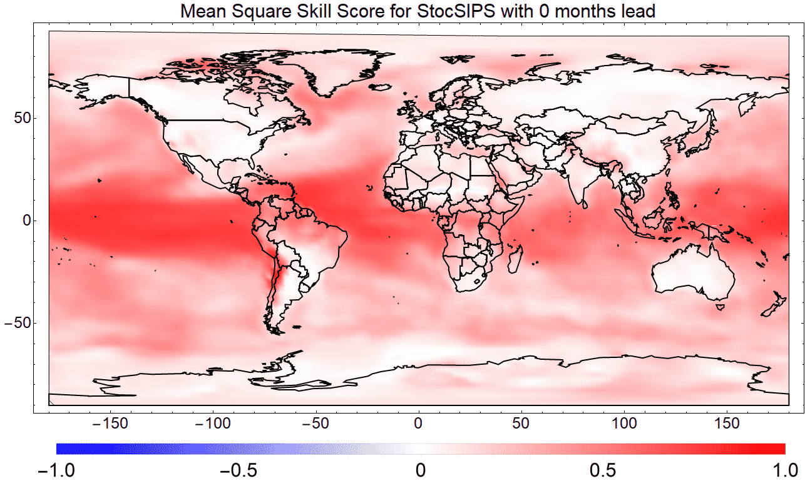
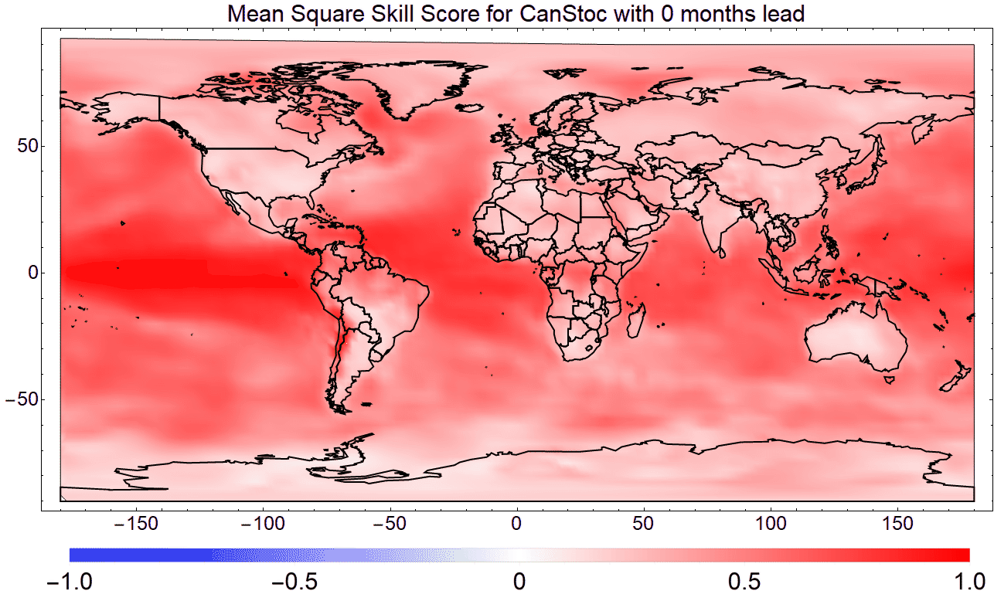
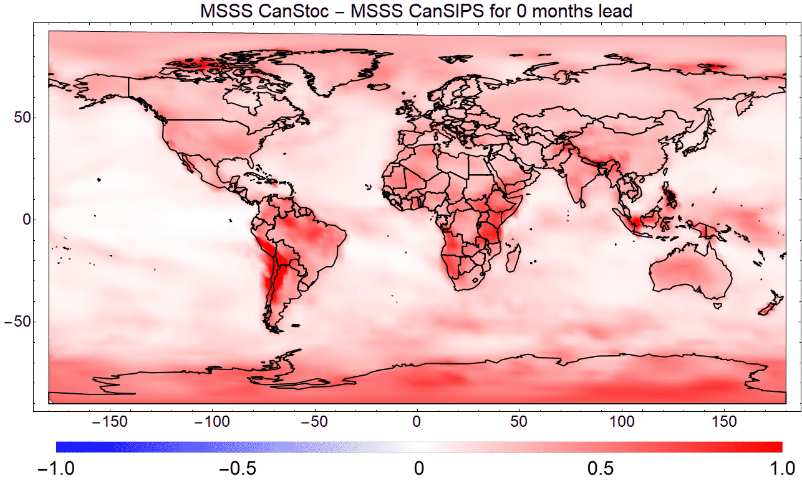
0-months lead Skill (hindcasts 1980-2010)
CanSIPS (GCM)
StocSIPS
Red: high skill, blue, low skill
CanStoc - CanSIPS
Red: CanStoc higher skill than CanSIPS
CanStoc (hybrid)

Slide 39
Using scaling for climate projections
Linearity, scaling of the response
Based on low frequency response of the Fractional Energy Balance Equation:
t>>τ
τ ≈ 2yrs
H ≈ 0.4
With R. Hébert 2017

Slide 40
Moderate mitigation scenario (RCP 4.5)
ΔT ºC
IPCC projection:
32 GCMs
IPCC: 90% uncertainty for
1.5ºC
Scaling memory
1.5 ºC
Short memory
historical exceeds 1.5ºC
With R. Hébert
See poster NP3.2 tomorrow
Notes:
7b

Slide 41
Validation: the historical method reproduces the past and predicts the GCMs
Projection of the Mean of the GCM’s using scaling
RCP 4.5
Mean of 32 GCMs (numerical integration)
Hybrid
Temperature with respect to 1880-1900 average (ºC)
Projection of historical data using scaling
historical
projections
Conclusion: GCMs (nearly) linearly project the past… but their climates are unrealistic. Better to project the observations
With R. Hébert

Slide 42
(Conclusions 1)
1970’s -2010’s: Two revolutions
Numerical
Nonlinear
Richardson’s strands
Deterministic
Stochastic
Co-existence
2010’s: Unity refound?
NWP’s, GCMs respect scaling laws…
Control runs and macroweather can be stochastically forecast…
Scaling yields improved climate projections

Slide 43
(Conclusions 2)
New answers…
Atmospheric variability?
Underestimated by quadrillion
Which Chaos?
Deterministic and Stochastic
Which level?
Low and High
What is weather? The climate?
….Macroweather!
…. New Questions
The details?
Scalebound or scaling?
Supercomputers or laptops?
What are the stochastic predictability limits?
Is civilisation the result of freak macroweather ?
Short course: Wednesday 16:15, room -2.31:
Topics in scale and scaling (with F. Schmitt)
Short Course: Thursday 8:30, room -2.16
Scale and Scaling in the climate system (with C. Franzke, T. Laepple)
Notes:
20 minutes

