Slide 1
Superconformal symmetry and higher-derivative Lagrangians
Antoine Van Proeyen
KU Leuven
Mc Gill university, workshop in honour of Marc Grisaru
April 19, 2013
Notes:
1

Slide 2
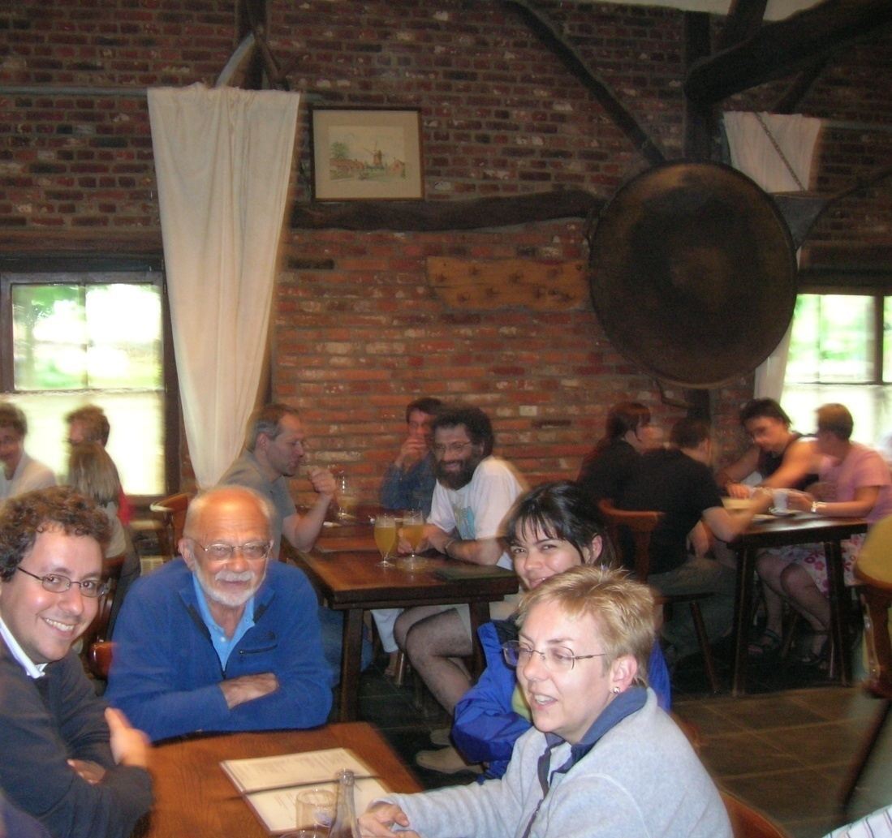
My experience with Marc
First encounter: on boat to Cargèse 1979
Only one paper together
but many long discussions,
e.g. while walking along the sea in Trieste on
massive gravitino superfield
and very nice moments together

Slide 3
Interest in higher-derivative terms
appear as ®⁰ terms in effective action of string theory
corrections to black hole entropy
higher order to AdS/CFT correspondence
counterterms for UV divergences of quantum loops

Slide 4
Plan
What we know about general sugra/susy theories
The superconformal method
Higher derivative sugra actions and sugra loop results
Dirac-Born-Infeld− Volkov-Akulov
and deformation of supersymmetry
(example of an all order higher-derivative susy action)
Conclusions

Slide 5
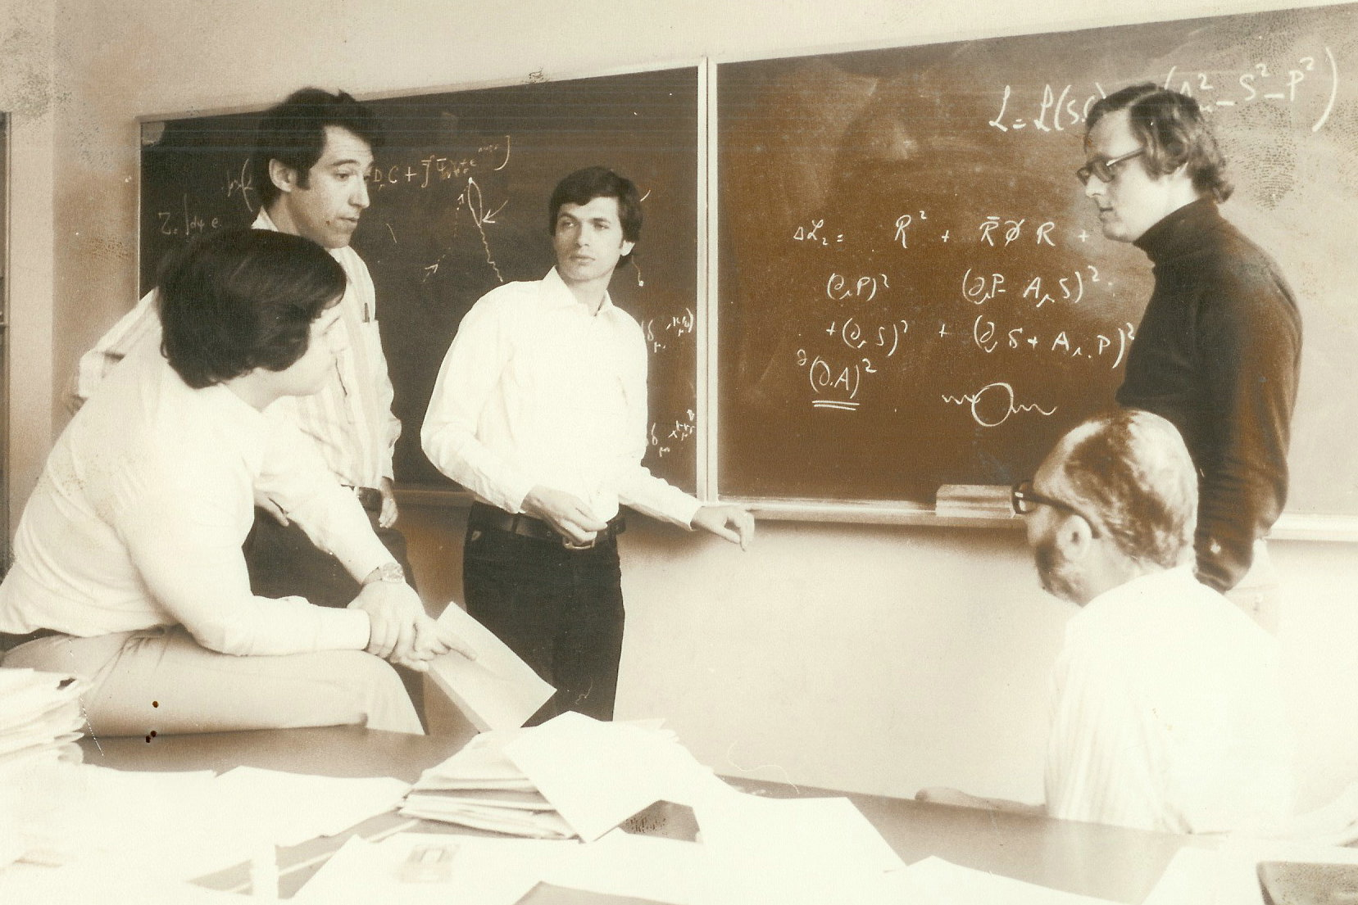
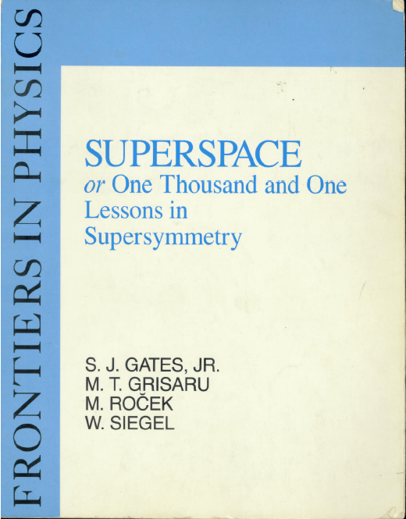
1. What we know about general sugra/susy theories

Slide 6
The map: dimensions and
# of supersymmetries
Strathdee,1987
D | susy | 32 |  | 24 | 20 | 16 |  | 12 | 8 | 4
11 | M | M
10 | MW | IIA | IIB |  |  | I
9 | M | N=2 |  |  |  | N=1
8 | M | N=2 |  |  |  | N=1
7 | S | N=4 |  |  |  | N=2
6 | SW | (2,2) |  | (2,1) |  | (1,1) | (2,0) |  | (1,0)
5 | S | N=8 |  | N=6 |  | N=4 |  |  | N=2
4 | M | N=8 |  | N=6 | N=5 | N=4 |  | N=3 | N=2 | N=1
 |  | SUGRA |  |  |  | SUGRA/SUSY |  | SUGRA | SUGRA/SUSY
vector multiplets +
multiplets up to spin 1/2
vector multiplets
tensor multiplet

Slide 7
Higher-derivative actions: no systematic knowledge
without higher derivatives:
ungauged and gauged supergravities.
Insight thanks to embedding tensor formalism
Various constructions of higher derivative terms
  e.g. susy Dirac-Born-Infeld: Deser, Puzalowski, 1980;
  Cecotti, Ferrara; Tseytlin; Bagger, Galperin; Roček;
  Kuzenko, Theisen; Ivanov, Krivonos, Ketov; Bellucci,
but no systematic construction,
or classification of what are the possibilities;
(certainly not in supergravity)

Slide 8
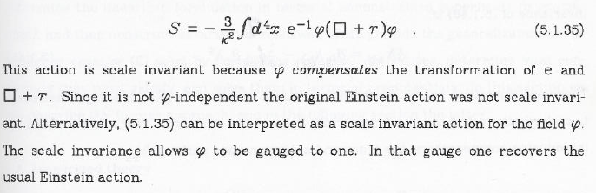
2. The superconformal method
from
one thousand
and one lectures
conformal scalar action
(contains Weyl fields)
local conformal symmetry
Gauge fix
dilatations and
special conformal transformations
Poincaré gravity action
local ¡ symmetry

Slide 9
Superconformal construction
The idea of superconformal methods
Difference susy- sugra: the concept of multiplets is clear in susy, they are mixed in supergravity
Superfields are an easy conceptual tool for rigid susy
(Super)gravity can be obtained by starting with (super)conformal symmetry and gauge fixing.
With matter:
Before gauge fixing: everything looks like in rigid supersymmetry + covariantizations

Slide 10
The strategy : superconformal construction of N=1 supergravity
chiral multiplet + Weyl multiplet
superconformal action
Gauge fix dilatations,
special conformal transformations,
local R-symmetry and
special supersymmetry
Poincaré supergravity action
S. Ferrara, M. Kaku, P.K. Townsend. P. van Nieuwenhuizen, 1977-78

Slide 11

More explanations

Slide 12
Superconformal construction of N=4 supergravity
De Roo, 1985
Weyl multiplet
+
6 gauge compensating multiplets (on-shell)
superconformal action
no flexibility in field equations !!
gauge-fixing
Weyl symmetry, local SU(4), local U(1) ,
S-supersymmetry and K-conformal boosts
pure N=4 Cremmer-Scherk-Ferrara supergravity

Slide 13
In which sugras can we use superconformal methods ?
We should have a superconformal algebra: superalgebra where bosonic part is direct product :
conformal £ R-symmetry
We should have compensating multiplets:
i.e. matter multiplets

Slide 14
The map: dimensions and
# of supersymmetries
D | susy | 32 |  | 24 | 20 | 16 |  | 12 | 8 | 4
11 | M | M
10 | MW | IIA | IIB |  |  | I
9 | M | N=2 |  |  |  | N=1
8 | M | N=2 |  |  |  | N=1
7 | S | N=4 |  |  |  | N=2
6 | SW | (2,2) |  | (2,1) |  | (1,1) | (2,0) |  | (1,0)
5 | S | N=8 |  | N=6 |  | N=4 |  |  | N=2
4 | M | N=8 |  | N=6 | N=5 | N=4 |  | N=3 | N=2 | N=1
 |  | SUGRA |  |  |  | SUGRA/SUSY |  | SUGRA | SUGRA/SUSY
have SC algebra
can be used for SC methods
vector multiplets +
multiplets up to spin 1/2
vector multiplets
tensor multiplet

Slide 15
3. Higher derivative supergravity actions and supergravity loop results
many miraculous cancellations have been found
is there an underlying hidden symmetry ?
If there are divergences:
supersymmetric counterterms should exist
(or supersymmetry anomalies)
We do not know enough to be sure
whether (or which type of) invariants do exist.

Slide 16
Higher derivative sugra actions
for low N there is a superconformal tensor calculus: allows to construct counterterms and even anomalies
→ superconformal symmetry allows divergences.
for N=4: superconformal symmetry can be defined, but no construction of counterterms (or anomalies)
  difficulty: on-shell susy algebra:
  to change action (add counterterms),
  one has to change simultaneously the transformations.

Slide 17


How do we get anomalies for low N from tensor calculus ?
^{de Wit,} ^{Grisaru 1985}

Slide 18
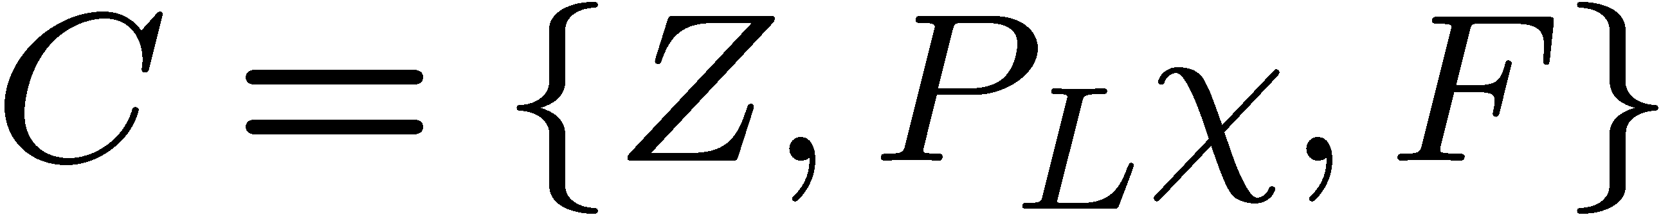
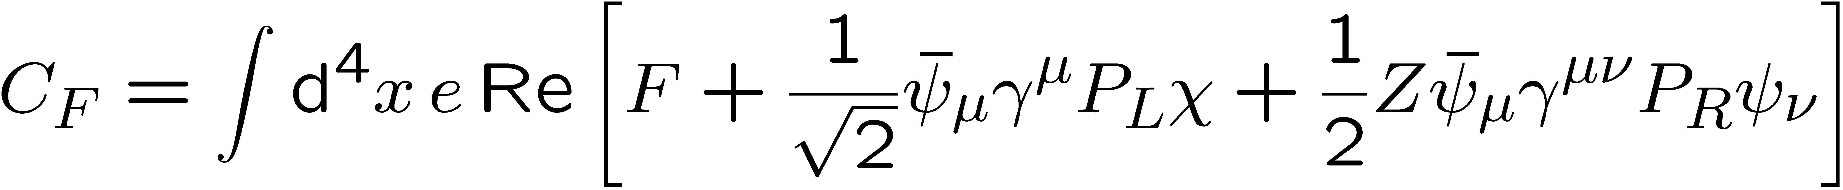
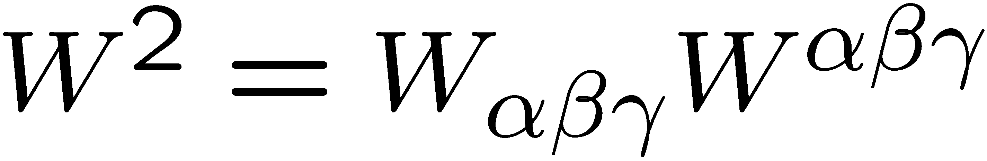
Anomalies from tensor calculus for low N ? (here N=1)
^{de Wit,} ^{Grisaru 1985}
N=1: local superconformal anomalies
satisfying Wess-Zumino consistency condition can be
constructed using superconformal tensor calculus
Compensator superfield transforms as
for

Slide 19
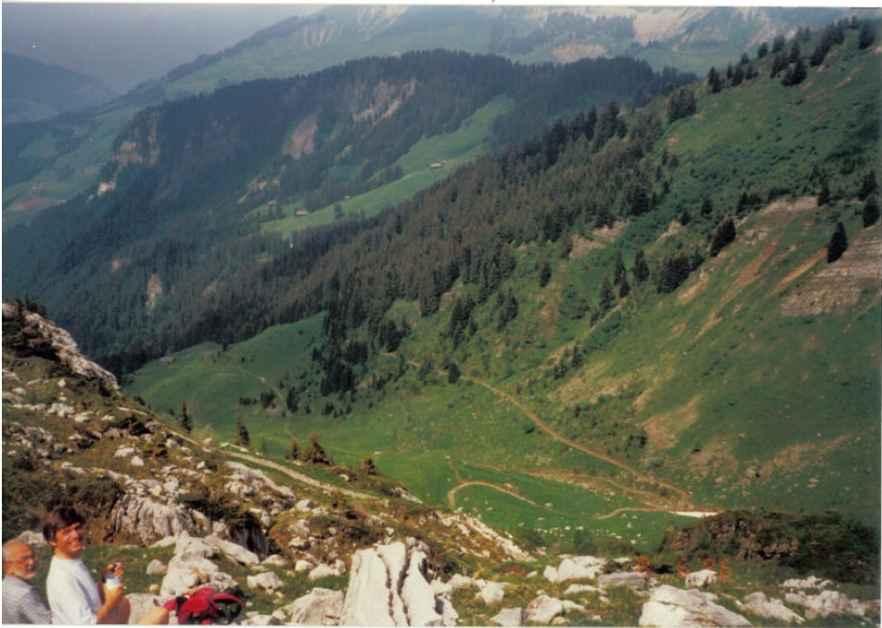
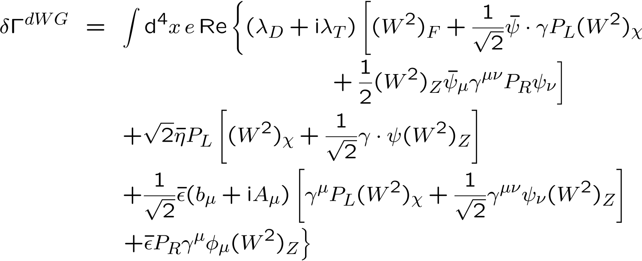

Slide 20
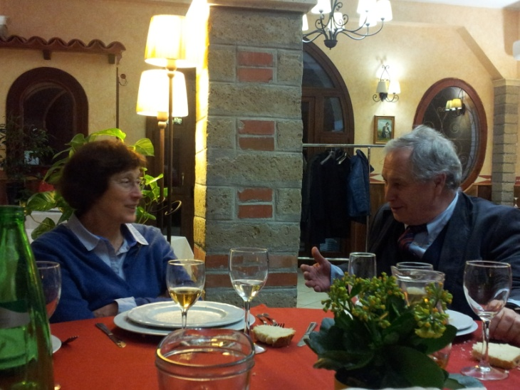
How for N=4 ?
No tensor calculus; no auxiliary fields;
only on-shell construction: no flexibility in field equations
How to establish the existence/non-existence of the consistent order by order deformation of N=4 on shell superspace ?
Conjecture: if it does not exist: explanation of finiteness
(if Bern et al do not find N=4, D=4 is divergent at higher loops)
Until invariant counterterms are constructed (conformal?)
we have no reason to expect UV divergences
Two points of view
1. Legitimate counterterms are not available yet
2. Legitimate counterterms are not available, period
???
S. Ferrara, R. Kallosh, AVP, 1209.0418

Slide 21
N=4 conjecture
“We are trying to prove ourselves wrong as quickly as possible, because only in that way can we find progress.” (Feynman)
If the UV finiteness will persist in higher loops, one would like to view this as an opportunity to test some new ideas about gravity.
E.g. : is superconformal symmetry more fundamental ?
Repeat: Classical N=4 is obtained from gauge fixing a superconformal invariant action:
The mass M_{Pl} appears in the gauge-fixing procedure
Bergshoeff, de Roo, de Wit, van Holten and AVP, 1981; de Roo, 1984
Analogy:
Mass parameters M_{W} and M_{Z} of the massive vector mesons are not present in the gauge invariant action of the standard model.
Show up when the gauge symmetry is spontaneously broken.
In unitary gauge they give an impression of being fundamental.
In renormalizable gauge (where UV properties analyzed) : absent
S. Ferrara, R. Kallosh, AVP, 1209.0418

Slide 22
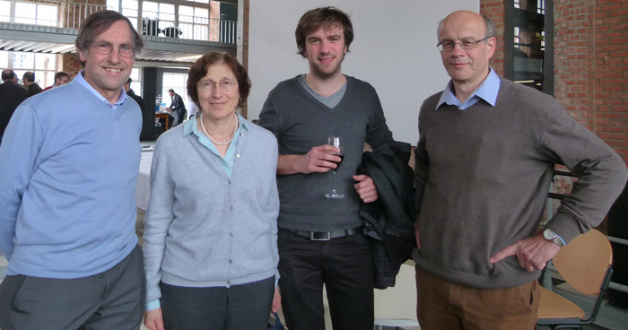

4. Dirac-Born-Infeld− Volkov-Akulov and deformation of supersymmetry
on the search of deformations of N=4 theories,
we find all-order invariant actions in rigid susy with
extra supersymmetries (Volkov-Akulov (VA) – type)
E. Bergshoeff, F. Coomans, C. Shahbazi, R. Kallosh, AVP,
arXiv:1303.5662

Slide 23
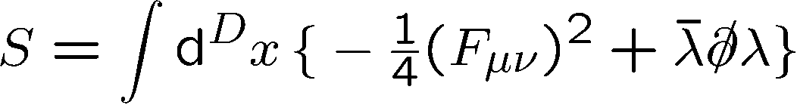
Bottom-up approach: start deformations
Dim | Spinor | min.# comp
2 | MW | 1
3 | M | 2
4 | M | 4
5 | S | 8
6 | SW | 8
7 | S | 16
8 | M | 16
9 | M | 16
10 | MW | 16
11 | M | 32
gauge field (D-2) on-shell dof;
fermion = #spinor comp / 2

Slide 24
The map: dimensions and
# of supersymmetries
D | susy | 32 |  | 24 | 20 | 16 |  | 12 | 8 | 4
11 | M | M
10 | MW | IIA | IIB |  |  | I
9 | M | N=2 |  |  |  | N=1
8 | M | N=2 |  |  |  | N=1
7 | S | N=4 |  |  |  | N=2
6 | SW | (2,2) |  | (2,1) |  | (1,1) | (2,0) |  | (1,0)
5 | S | N=8 |  | N=6 |  | N=4 |  |  | N=2
4 | M | N=8 |  | N=6 | N=5 | N=4 |  | N=3 | N=2 | N=1
 |  | SUGRA |  |  |  | SUGRA/SUSY |  | SUGRA | SUGRA/SUSY
vector multiplets +
multiplets up to spin 1/2
vector multiplets
tensor multiplet

Slide 25
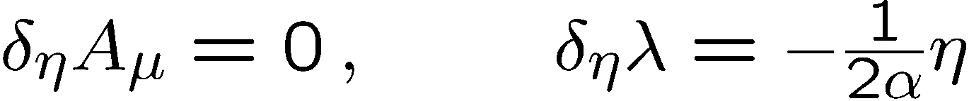
Bottom-up approach: start deformations
Dim | Spinor | min.# comp
2 | MW | 1
3 | M | 2
4 | M | 4
5 | S | 8
6 | SW | 8
7 | S | 16
8 | M | 16
9 | M | 16
10 | MW | 16
11 | M | 32
D=10: MW;
D=6 SW;
D=4 M;
D=3 M;
D=2 MW
gauge field (D-2) on-shell dof;
fermion = #spinor comp / 2
extra (trivial) fermionic shift symmetry
normalization for later use

Slide 26
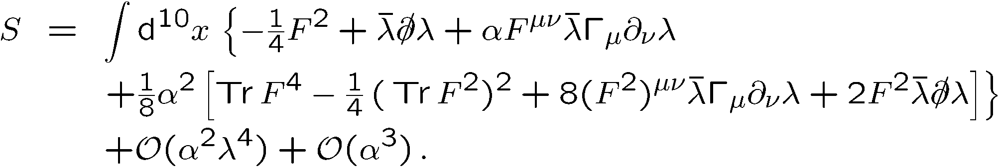
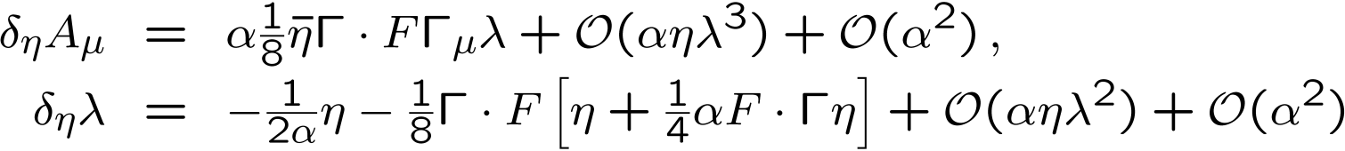
Bottom-up deformation
answer unique up to field redefinitions
also transformation rules deformed.
As well ² as ´ parameter transformations can be defined
e.g.
Only identities used that are valid in D=10,6,4,3,
e.g. cyclic (Fierz) identity
looks hopeless to continue to all orders
continues from work in D=6 : E. Bergshoeff, M. Rakowski and E. Sezgin, 1987

Slide 27
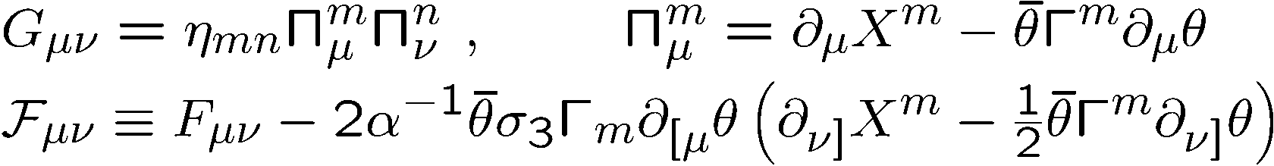
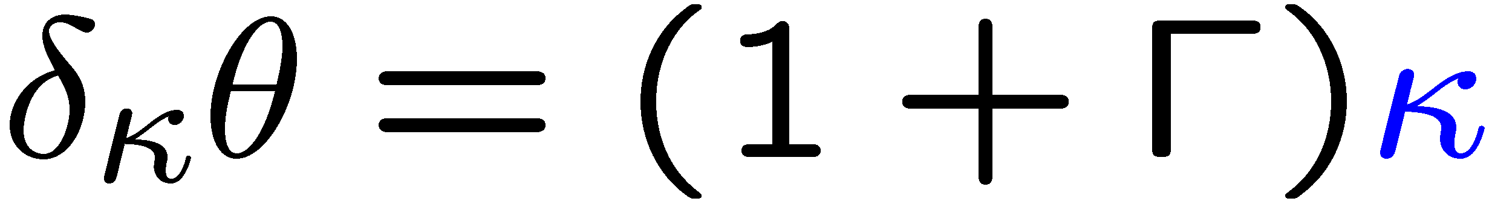
Dp-brane action
Start with –symmetric Dp brane action
Dp brane: IIB theory m=0,..., 9 and ¹=0,..., p=2n+1
space-time coördinates X^{m}; µ is doublet of MW spinors;
F_{¹º} Abelian field strength
Same applies for D=6 (2,0) (also called iib):
m=0,...,5
Symmetries:
rigid susy doublet ²¹; ²²
local  symmetry doublet (effectively only half (reducible) symmetry)
world volume gct
Also D=4 N=2, m=0,...,3 (BH solutions)

Slide 28
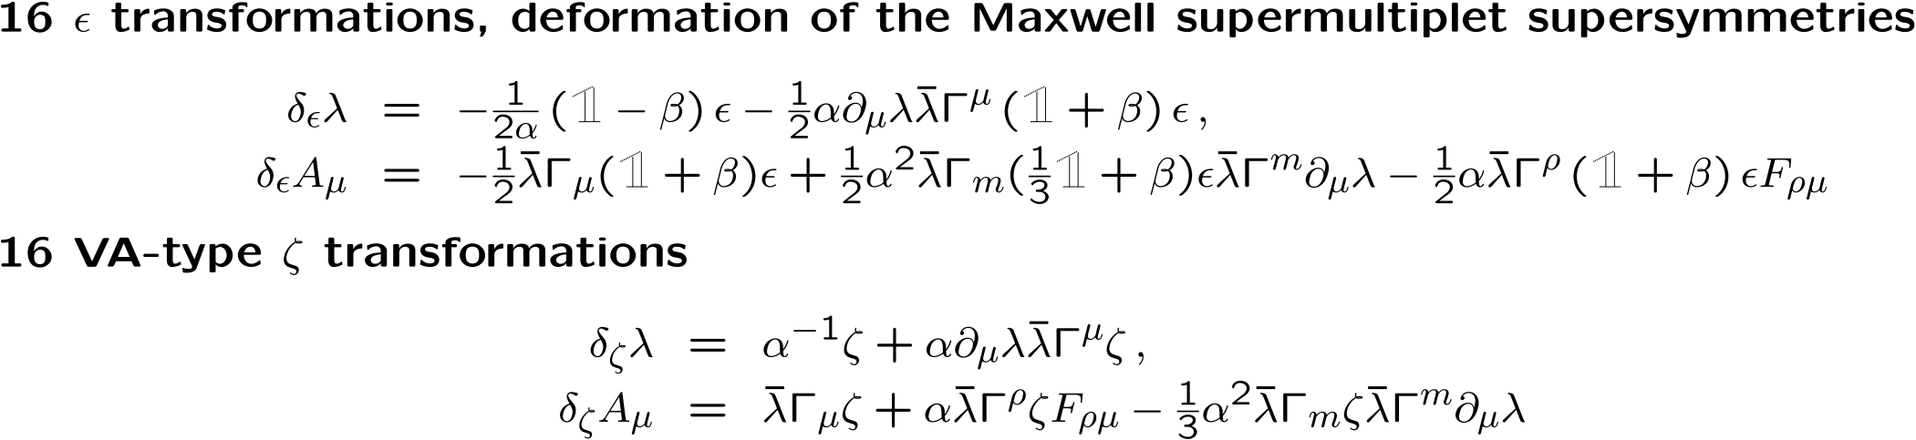

After gauge fixing
worldvolume gct »^{m’} and  symmetry gauge-fixed:
only one fermion, ¸, remains
⇒ ²¹ and ²² supersymmetries preserved
suitable combinations are called ² and ³ : act as
ordinary susy: deformed at order ®
VA susy

Slide 29
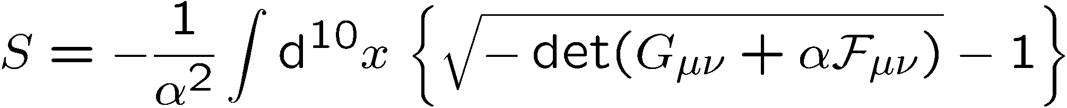
Complete DBI-VA model for the p=9 case
Expanding the all-order result, one re-obtains indeed the result that was obtained in the bottom-up calculation to order ®²
This proves that our all-order result is indeed
the full deformation that we were looking for !

Slide 30
The map: dimensions and
# of supersymmetries
D | susy | 32 |  | 24 | 20 | 16 |  | 12 | 8 | 4
11 | M | M
10 | MW | IIA | IIB |  |  | I
9 | M | N=2 |  |  |  | N=1
8 | M | N=2 |  |  |  | N=1
7 | S | N=4 |  |  |  | N=2
6 | SW | (2,2) |  | (2,1) |  | (1,1) | (2,0) |  | (1,0)
5 | S | N=8 |  | N=6 |  | N=4 |  |  | N=2
4 | M | N=8 |  | N=6 | N=5 | N=4 |  | N=3 | N=2 | N=1
 |  | SUGRA |  |  |  | SUGRA/SUSY |  | SUGRA | SUGRA/SUSY
D9
D7
D5
D3
vector multiplets +
multiplets up to spin 1/2
vector multiplets
tensor multiplet

Slide 31
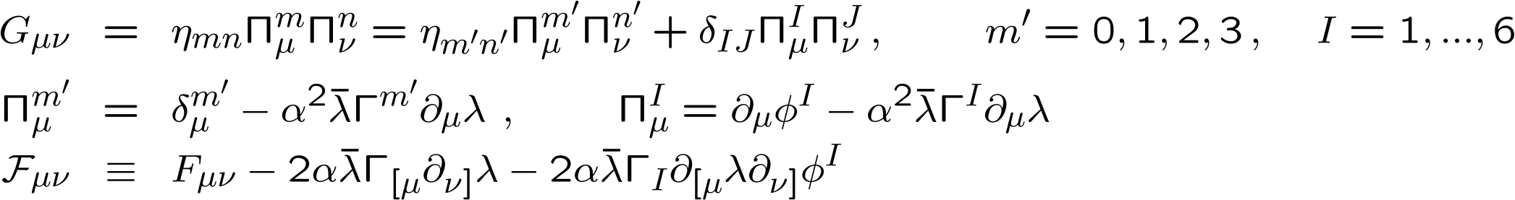
Complete DBI-VA model for the p=3 case
16 ² and 16 ³ (VA) symmetries and shift symmetry of scalars
Can be compared with N = 4 , D=4:
using a suitable ¡ - matrix representation, lowest order is
standard susy-Maxwell with 4 Majorana spinors and 6 scalars)
Since the action is invariant at all orders under 16+16 supersymmetries, this is the full result !

Slide 32
The map: dimensions and
# of supersymmetries
D | susy | 32 |  | 24 | 20 | 16 |  | 12 | 8 | 4
11 | M | M
10 | MW | IIA | IIB |  |  | I
9 | M | N=2 |  |  |  | N=1
8 | M | N=2 |  |  |  | N=1
7 | S | N=4 |  |  |  | N=2
6 | SW | (2,2) |  | (2,1) |  | (1,1) | (2,0) |  | (1,0)
5 | S | N=8 |  | N=6 |  | N=4 |  |  | N=2
4 | M | N=8 |  | N=6 | N=5 | N=4 |  | N=3 | N=2 | N=1
 |  | SUGRA |  |  |  | SUGRA/SUSY |  | SUGRA | SUGRA/SUSY
D9
D7
D5
V5
D3
V3
vector multiplets +
multiplets up to spin 1/2
vector multiplets
tensor multiplet

Slide 33
Possible relation with special supersymmetry
Old work: world-volume theory in AdS background
AdS (super)isometries lead in the same way to two supersymmetries
after gauge fixing of  and GCT on brane: ordinary and special supersymmetry
→ superconformal algebra on brane.
P. Claus, R. Kallosh and AVP, hep-th/9711161 and 9812066
P. Claus, R. Kallosh, J. Kumar, P. Townsend and AVP, hep-th/9711161

Slide 34
5. Conclusions
Superconformal symmetry has been used as a tool for constructing classical actions of supergravity.
Uses many concepts of superspace, reformulated as multiplets transforming under superconformal group.
We do not have a systematic knowledge of higher-derivative supergravity actions.
Can (broken) superconformal symmetry be an extra quantum symmetry?
The non-existence of (broken) superconformal-invariant counterterms and anomalies in N=4, D=4 could in that case explain ‘miraculous’ vanishing results.
We are studying new constructions of higher-derivative actions using gauge-fixed brane actions. For now: rigid supersymmetry.

Slide 35
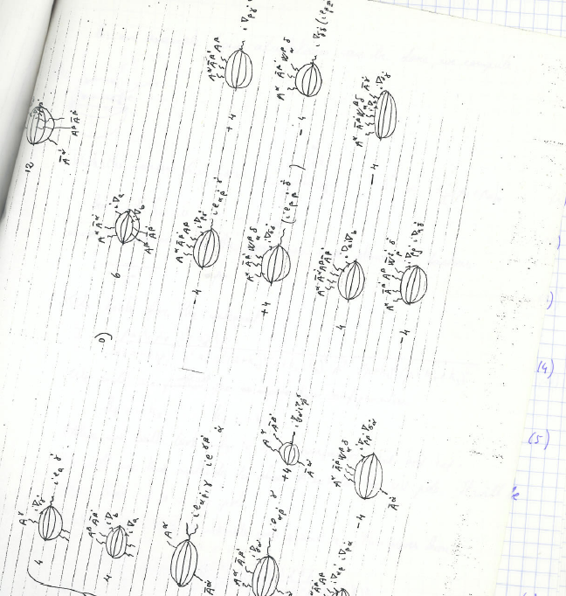
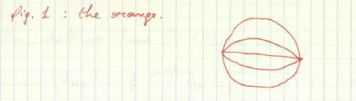
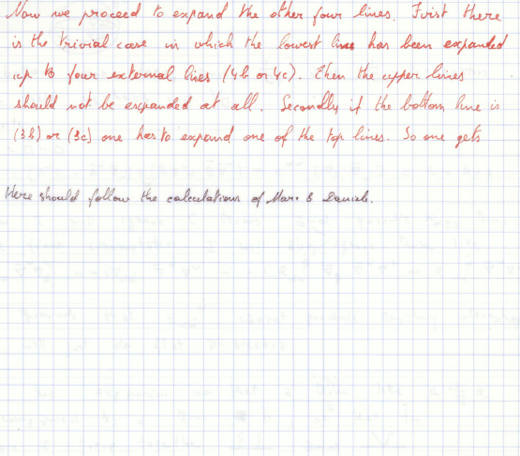
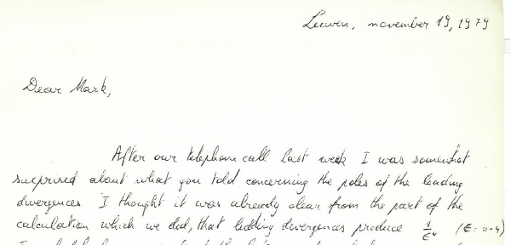
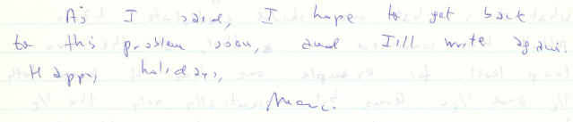
More work to do ...
Import in superconformal
or there is still always

Slide 36
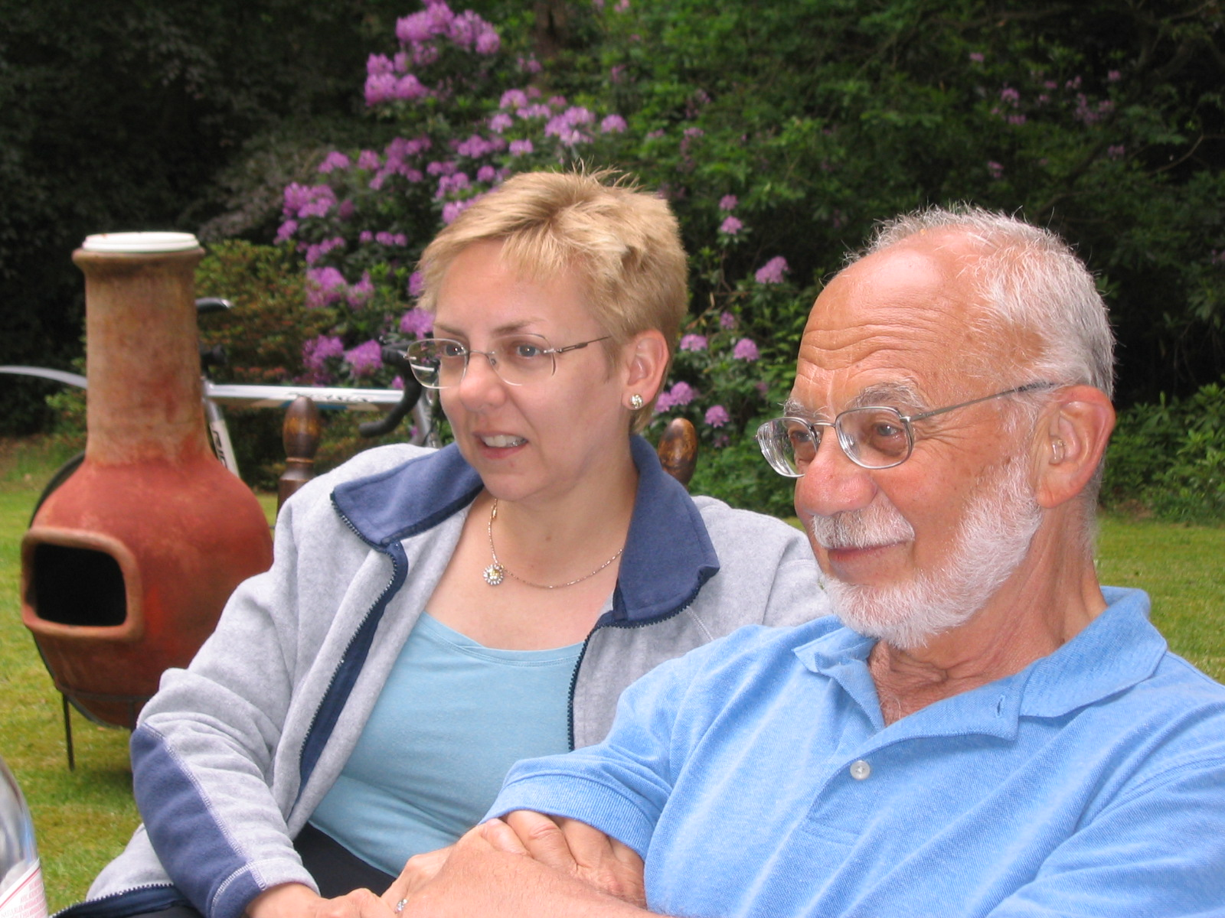
many happy returns !

